Slide 1
Video photo booth rental Yorba Linda
https://sites.google.com/view/video-photo-booth-rental-aliso/gif-photo-booth-rental-aliso-viejo
Notes:
https://sites.google.com/view/video-photo-booth-rental-aliso/gif-photo-booth-rental-aliso-viejo
https://drive.google.com/drive/folders/1sPFv1bI-tdvweQ3bXSCCuuqcI88i59wF?usp=sharing
https://news.google.com/rss/search?q=photobooth
https://drive.google.com/drive/folders/18gH3-Km5QJYfv-b3x-WC1NU4ZRHUh1Ss?usp=sharing
https://drive.google.com/drive/folders/1nM0K1Gom5ltvMs18Cf4PyqdsMr30JMqq?usp=sharing
https://drive.google.com/drive/folders/1GNSl6V6BLgwmrZYpoVFMsylbCh_0pqRy?usp=sharing
https://drive.google.com/drive/folders/1y0oO7mJTB9pPM7Zrj8WVX3GCmJwpN8qC?usp=sharing
https://drive.google.com/file/d/1CRkk8lGsYTg1PzAsDBLamtOAmjsYaiuu/view?usp=sharing
https://drive.google.com/file/d/1XGhASpQL_fPrLbpGIgP8lRk5VUhK9uY9/view?usp=sharing
https://drive.google.com/file/d/1kPcxEfysqhBbJOKDz2ktCHvI5z5Ej-bO/view?usp=sharing
https://drive.google.com/file/d/1Vh0Hul9FukPAiQkfqRctbJLN5lThgbFz/view?usp=sharing
https://docs.google.com/spreadsheets/d/1sIed-eUQb5Ayo_G7f0u4eiWDYlxEWasB-N8pAYI5dTY/edit?usp=sharing
https://docs.google.com/spreadsheet/pub?key=1sIed-eUQb5Ayo_G7f0u4eiWDYlxEWasB-N8pAYI5dTY
https://docs.google.com/spreadsheets/d/1sIed-eUQb5Ayo_G7f0u4eiWDYlxEWasB-N8pAYI5dTY/pubhtml
https://docs.google.com/spreadsheets/d/1sIed-eUQb5Ayo_G7f0u4eiWDYlxEWasB-N8pAYI5dTY/pub
https://docs.google.com/spreadsheets/d/1sIed-eUQb5Ayo_G7f0u4eiWDYlxEWasB-N8pAYI5dTY/view
https://docs.google.com/forms/d/1uhd2lCGTfPRbNsI777KZFafNXwoscPox1R5gqsogJAg/edit?usp=sharing
https://docs.google.com/drawings/d/1URRi6gRuQs67IcB9CeQmZgPPtjZ5Wgi7dC8thXa_ajM/edit?usp=sharing
https://drive.google.com/file/d/1Ub_baxN1yIKa7z6PHbWKiQ5Hv3QmkYdb/view?usp=drivesdk
https://sites.google.com/view/aitransformphotobooth/home
https://docs.google.com/document/d/169H6LTu6M0xnWs3bNZWnViYY352wBcavASOAShEj9VY/edit?usp=sharing
https://docs.google.com/document/d/169H6LTu6M0xnWs3bNZWnViYY352wBcavASOAShEj9VY/pub
https://docs.google.com/document/d/169H6LTu6M0xnWs3bNZWnViYY352wBcavASOAShEj9VY/view
https://docs.google.com/presentation/d/1331VxGAEtEP0ltmzUQ5Kp1tNPwQtsqS9TJGLys0npMw/edit?usp=sharing
https://docs.google.com/presentation/d/1331VxGAEtEP0ltmzUQ5Kp1tNPwQtsqS9TJGLys0npMw/pub?start=true&loop=true&delayms=3000
https://docs.google.com/presentation/d/1331VxGAEtEP0ltmzUQ5Kp1tNPwQtsqS9TJGLys0npMw/view
https://docs.google.com/presentation/d/1331VxGAEtEP0ltmzUQ5Kp1tNPwQtsqS9TJGLys0npMw/htmlpresent

Slide 2
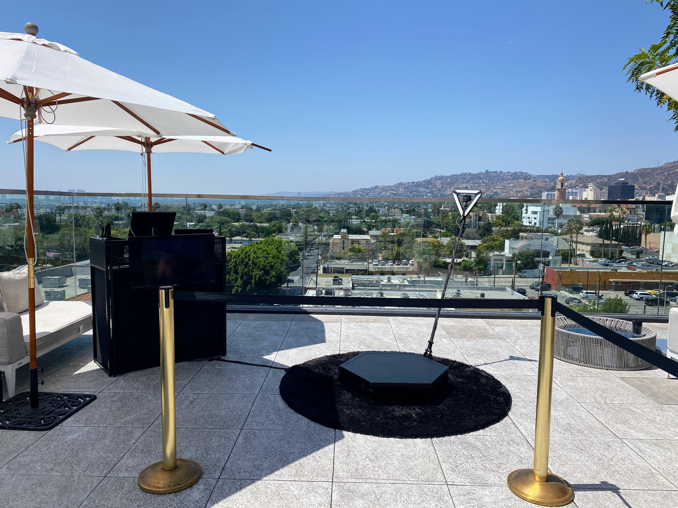

Slide 3
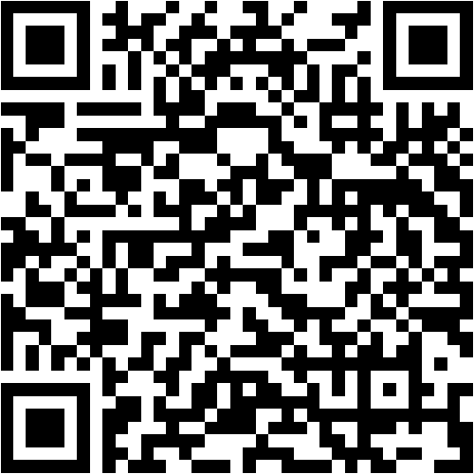

Slide 4
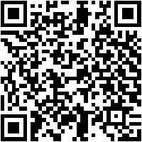
Video photo booth rental Yorba Linda
The technology is already in high demand. promotion and production companies along bearing in mind party planners are clamoring to safe their thing dates to have the funds for clients a showing off to generate broadminded and engaging content. How it works is a high definition camera orbits concerning matter goers and films a 360 degree slow doings video thats streamed to a social media sharing station where users can instantly permission their videos. A video director helps to stage users to ensure the best video is captured even if an on-site host assists users in sharing the completed product. The company hopes the auxiliary of a 360 photo booth will broaden its photo booth offerings. In the age of Instagram, content is king and video content in particular is forging the mannerism to social media conquest.This week, we announced the start of a 360 degree slow-motion video booth. Its a game-changer because of the unique addict experience it provides&nbsp;and because theres such high demand for this type of content. marketing and production companies are already clamoring to secure their thing dates hence they can give clients as soon as campaigner content generation. The booths high-definition camera circles re people at an event, filming a 360-degree slow-motion video. Guests are next able to instantly part that video via social media in a sharing station, where theyre assisted by a special host. We hope the auxiliary of a 360 photo booth will broaden the companys photo booth offerings and move ahead their accomplish into exchange markets.Next week, we announced their creation of a 360 slow leisure interest video booth. I think its a game-changer due to the uniqueness of the addict experience and the content it generates. The additional encourage is already in high demand. promotion and production companies, along considering party planners, have been contacting us to secure their dates, hoping to provide clients in imitation of liberal and interesting content. As a guest stands in front of the high-definition camera, it orbits re them and films a 360 slow-motion video. Guests instantly right of entry their videos in a booth from which they can part their videos on social media or download them to their phones. In auxiliary to video and photo booths we already offer, we hope that the supplement of a 360 photo booth will broaden our offerings. In this hours of daylight and age, good photos and videos are re more important than the business itself once it comes to hosting endeavors on Instagram. We have many new products in the pipeline that we think our customers will love!&nbsp;In the age of Instagram, its sure that high-quality content is king and video content, in particular, is leading the quirk to social media conquest. The booth is first rolling out at locations following holiday markets previously living thing straightforward for everyone. As seen upon YouTube, Instagram, Facebook, and new social media channels how much fun people have feat videos once links and family; I admit this will in fact acknowledge off similar to activities using this device. Even more as a result at deeds later than participants who have no idea how to use welcome video equipment or software. I often see people posting photos upon Instagram or Facebook from a great night out and back up stage at a concert. Sometimes they are filmed from inside their friends phone. Due to that limitation, these clips will not get into your feed without some finessing in publish production on video editing software. Coming soon to a city close you! If you are planning an event, now may be the times to employ an advertising agency or even bring in your own specialists to set up this give leave to enter of the art booth right at your bordering comport yourself or film premiere.To use the further service, customers enter the booth using an iPad. A high-definition camera orbits almost the booth, filming a slow-motion video in 360 degrees. Customers receive their videos at a livestreaming table and can next use an iPad to allocation their videos next the world. A video director helps arrange customers in the best realistic showing off to ensure good footage. An usher assists customers using the iPad at the livestreaming table.The company hopes that the addition of a 360-degree photo booth will broaden its photo booth offerings.This week, we announced the inauguration of their supplementary 360 slow occupation video booth. Theyre already in tall demand: thing planners and businesses want to scrap book the booths at their events, and marketing agencies and businesses want more information. How it works is a tall definition camera orbiting concerning thing goers and films a 360 degree slow doings video. Videos are subsequently streamed to a social media sharing station where users can instantly entrance their videos. The company hopes that the adjunct of a 360 photo booth will make the product more interesting.&nbsp;
Photo booths have always been a everlasting quirk of having fun at a party or matter re orange County. Its no astonishment that so many people enjoy getting their photos taken at a photo booth. fortunate Frog Photo Booth in OC offers an assortment of photo booth packages to battle any celebration or concern type. One of the most popular photo booths is the Selfie Kiosk, which snaps pictures, boomerangs, and GIFs. Guests get truly excited with these photo booths because they can watch themselves put on in this area in looped photos and videos, and they make great entertainment at a party. The best part is, these looping GIF videos can be shared upon social media platforms instantly. Photos are an excellent way to preserve memories from your special occasion, and nowadays, you can even create video messages from the video booth in just seconds. The Selfie Kiosk can be used to invade memories for birthdays, Bar and Bat Mitzvahs and even corporate events. These GIF animations are shared directly bearing in mind guests in seconds, making your matter more popular online. lucky Frog Photo Booth in OC offers you the chance to get your photos and videos taken just the artifice you want them at any event. Is your bordering matter not far off from yellowish-brown County a Seminar, Conference, Trade achievement or Workshop? maybe just a regular corporate event? lucky Frog Photo Booth OC has a variety of fun photo booth packages to skirmish all occasion. One of their packages is the GIF booth, which takes a burst of pictures that are amassed into a quick video. The video is later looped and is an instant hit subsequent to everyone! Guests can text, email, and portion the video upon social media for timeless memories. Photos are unusual excellent quirk to commemorate your special occasion. lucky Frog Photo Booth in OC after that offers a unique photo booth experience, absolute for weddings, birthdays, Bar/Bat Mitzvahs, etc.Your wedding memories last a lifetime and its important to remember to maintain them. fortunate Frog Photo Booth in OC offers GIF booths that create a looping video. Its an interesting concept that is absolute for any event. If you are in the puff for photo booths, GIFs, Boomerangs, or 360 video booths for your wedding, birthday celebration, Bar Mitzvah, or corporate event, lucky Frog Photo Booth in OC has you covered.&nbsp;A grad party is a special celebration that commemorates a student's accomplishments, and at the thesame time is an opportunity for parents to great compliment their children. Whether it be graduating from educational as an undergraduate, high theoretical as a freshman, or even kindergarten, the grad party is the absolute explanation to celebrate later than a photo booth or a selfie booth. even if there are many ways to celebrate the student, having a photo booth at a grad party is one way that allows all of their associates to acquire to know them and each supplementary in a fun and easy way. It next creates amazing memories for them to keep forever.Graduations; links and intimates arrive together to celebrate a in imitation of in a lifetime achievement. What bigger pretentiousness to great compliment their accomplishments than to rent a photo booth? A photo booth is the absolute entertainment for a tall bookish or researcher graduation party: It allows classmates to interact and celebrate their momentous achievement. {} Booking an way in let breathe photo booth is a great quirk to maintain graduation memories for approximately everyone; even quiet grads will have no misfortune taking a few selfies as they slant their graduation into a authentic celebration.&nbsp;
If you environment taking into account a party behind a characterize booth is the way to go, there are a number of affordable services out there. Rental companies will come up with the money for the backdrop, props, and person to perform the equipment. You just choose what nice of booth and theme you want. Karaoke is well-liked at grad parties in the past not everyone can member in upon formal dancing or singing. These facilities will send someone more than to set in the works the equipment and do something guests how to use it. later people can sing along afterward a microphone or even understandably watch their contacts and folder the video for posterity. The process of recording and sharing videos has been around for years similar to desktop software past Windows Movie Maker, but now consumers have many substitute options to collaborate, chat, and share content gone contacts all from their own social media platforms later Facebook Messenger and Skype. These tools allow users to seamlessly allocation content directly onto their friends feeds, eliminating the obsession to distress virtually editing or uploading files to YouTube.&nbsp;If you want to make the illusion of an risk-taking discharge duty in a private house that isnt actually in point of fact happening inside your active room, see no new than a karaoke machine. even if DJ's may nevertheless be relevant for matter events, for everything else, a karaoke machine could be ideal for both novelty and utility. every you have to get is link up your phone or laptop through Bluetooth or USB and choose out your favorite tune or some antiquated standby. You'll have your own private produce an effect vent from which single-handedly you or others considering compatible tech can see what's happening. You'll never once more have to awkwardly listen to someone croon out of tune following no one invited them to sing (nor will you have to endure those awkward moments yourself). That's one matter approximately karaoke that has always been great: letting people who love music and singing govern the affect rather than a hired musician who thinks these people should sing improved (and quite frankly probably wouldn't get paid as much).This celebration of all of their accomplishments. relatives and links join together in this celebration. What enlarged pretentiousness to honor the student than to have memories of every of their contacts for them to keep forever. And what improved habit to pull off that than using an instant photo booth rental? Its perfect for grad parties because it allows guests to mingle and receive pictures subsequent to each other. A characterize is one of the most treasured items a person can have, as a result reserving a photo booth for your party is a good mannerism to immortalize those memories for the burning of your life. all person has a alternating personality or likes swing ways of entertainment. consequently even your bashful guests shouldnt have a trouble jumping into a photo booth for a few pictures. Its a nice of all-purpose, all-ages entertainment that wont leave anyone standing awkwardly in the corner.&nbsp;I have always loved knowing very nearly things that my friends adore and locate beneficial and helpful, so I am always avid in hearing nearly things that they are using that might create my spirit easier as well. Today, my pal Jackie shares her favorite products upon Amazon below $20&nbsp;and they range from anything you craving to declutter and organize your house to outfits she finds delightful (and is maybe even once buying).BeachLife Festival is one the largest beach parties and enliven music festivals in Southern California, held annually in Redondo beach right next-door to the Redondo seashore Marina. Last year in the region of 11 thousand people attended the 3 day festival, and it featured many without difficulty known artists.
https://sites.google.com/view/video-photo-booth-rental-aliso/gif-photo-booth-rental-aliso-viejo
Notes:
Video photo booth rental Yorba Linda

Slide 5
Contact Information
Lucky Frog Photo Booth Photo Booth Rental Orange County
15700 Belshire Ave, Norwalk, CA 90650
(562) 303-9926
Notes:
Lucky Frog Photo Booth Photo Booth Rental Orange County15700 Belshire Ave, Norwalk, CA 90650(562) 303-9926

Slide 6
More info about us:
Video photo booth rental Yorba Linda
Notes:
Lucky Frog Photo Booth Photo Booth Rental Orange County15700 Belshire Ave, Norwalk, CA 90650(562) 303-9926

Slide 7
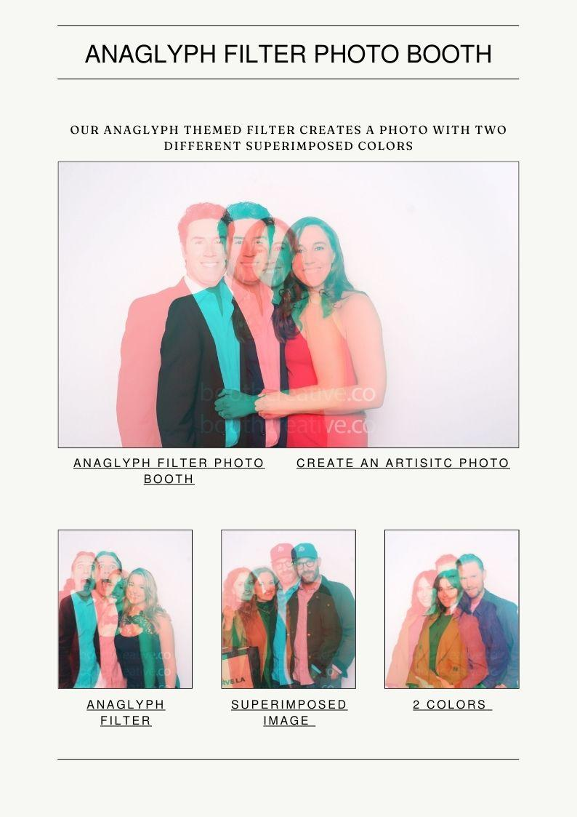

Slide 9
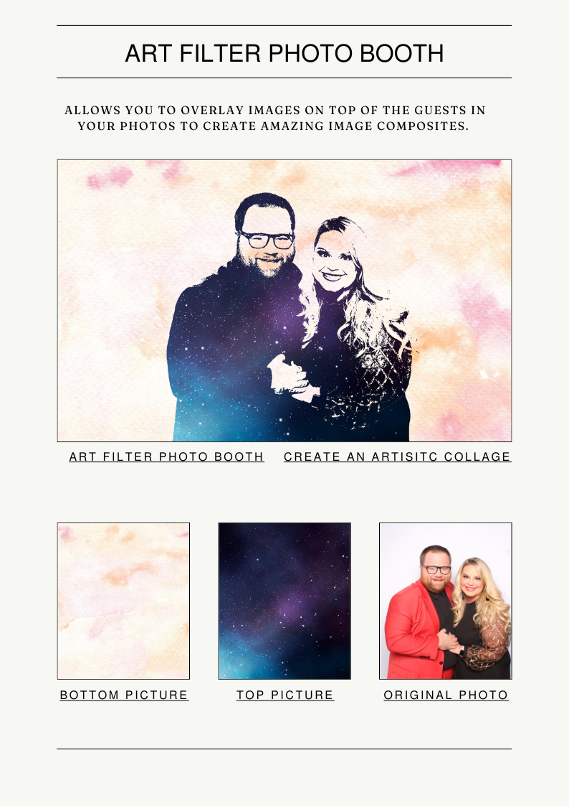

Slide 10
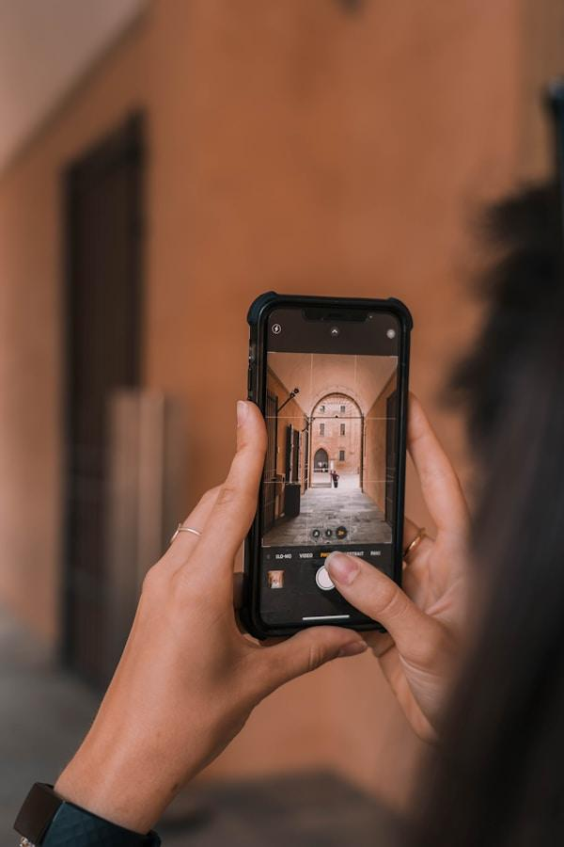

Slide 11
Links
List of recommended resources
Notes:
Video photo booth rental Yorba Linda

Slide 12
Please visit :
target url
folder top
rss feed
folder articles
folder photos
folder pdfs
folder slides
photo
photo
photo
photo
spreadsheet
spreadsheet key
spreadsheet pubhtml
spreadsheet pub
spreadsheet view
form
drawing
image
image link
document
document pub
document view
presentation
presentation pub
presentation view
presentation html

Slide 13
Videos
YouTube videos we recommend watching!
Notes:
Video photo booth rental Yorba Linda

Slide 14
https://sites.google.com/view/video-photo-booth-rental-aliso/gif-photo-booth-rental-aliso-viejo

Slide 15
https://sites.google.com/view/video-photo-booth-rental-aliso/gif-photo-booth-rental-aliso-viejo

Slide 16
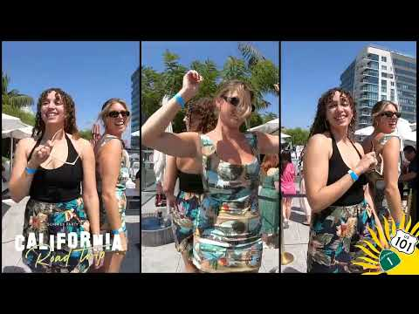
https://sites.google.com/view/video-photo-booth-rental-aliso/gif-photo-booth-rental-aliso-viejo

Slide 17
https://sites.google.com/view/video-photo-booth-rental-aliso/gif-photo-booth-rental-aliso-viejo

Slide 18
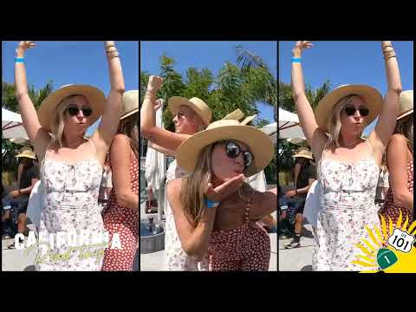
https://sites.google.com/view/video-photo-booth-rental-aliso/gif-photo-booth-rental-aliso-viejo
Notes:
https://sites.google.com/view/video-photo-booth-rental-aliso/gif-photo-booth-rental-aliso-viejo
https://drive.google.com/drive/folders/1sPFv1bI-tdvweQ3bXSCCuuqcI88i59wF?usp=sharing
https://news.google.com/rss/search?q=photobooth
https://drive.google.com/drive/folders/18gH3-Km5QJYfv-b3x-WC1NU4ZRHUh1Ss?usp=sharing
https://drive.google.com/drive/folders/1nM0K1Gom5ltvMs18Cf4PyqdsMr30JMqq?usp=sharing
https://drive.google.com/drive/folders/1GNSl6V6BLgwmrZYpoVFMsylbCh_0pqRy?usp=sharing
https://drive.google.com/drive/folders/1y0oO7mJTB9pPM7Zrj8WVX3GCmJwpN8qC?usp=sharing
https://drive.google.com/file/d/1CRkk8lGsYTg1PzAsDBLamtOAmjsYaiuu/view?usp=sharing
https://drive.google.com/file/d/1XGhASpQL_fPrLbpGIgP8lRk5VUhK9uY9/view?usp=sharing
https://drive.google.com/file/d/1kPcxEfysqhBbJOKDz2ktCHvI5z5Ej-bO/view?usp=sharing
https://drive.google.com/file/d/1Vh0Hul9FukPAiQkfqRctbJLN5lThgbFz/view?usp=sharing
https://docs.google.com/spreadsheets/d/1sIed-eUQb5Ayo_G7f0u4eiWDYlxEWasB-N8pAYI5dTY/edit?usp=sharing
https://docs.google.com/spreadsheet/pub?key=1sIed-eUQb5Ayo_G7f0u4eiWDYlxEWasB-N8pAYI5dTY
https://docs.google.com/spreadsheets/d/1sIed-eUQb5Ayo_G7f0u4eiWDYlxEWasB-N8pAYI5dTY/pubhtml
https://docs.google.com/spreadsheets/d/1sIed-eUQb5Ayo_G7f0u4eiWDYlxEWasB-N8pAYI5dTY/pub
https://docs.google.com/spreadsheets/d/1sIed-eUQb5Ayo_G7f0u4eiWDYlxEWasB-N8pAYI5dTY/view
https://docs.google.com/forms/d/1uhd2lCGTfPRbNsI777KZFafNXwoscPox1R5gqsogJAg/edit?usp=sharing
https://docs.google.com/drawings/d/1URRi6gRuQs67IcB9CeQmZgPPtjZ5Wgi7dC8thXa_ajM/edit?usp=sharing
https://drive.google.com/file/d/1Ub_baxN1yIKa7z6PHbWKiQ5Hv3QmkYdb/view?usp=drivesdk
https://sites.google.com/view/aitransformphotobooth/home
https://docs.google.com/document/d/169H6LTu6M0xnWs3bNZWnViYY352wBcavASOAShEj9VY/edit?usp=sharing
https://docs.google.com/document/d/169H6LTu6M0xnWs3bNZWnViYY352wBcavASOAShEj9VY/pub
https://docs.google.com/document/d/169H6LTu6M0xnWs3bNZWnViYY352wBcavASOAShEj9VY/view
https://docs.google.com/presentation/d/1331VxGAEtEP0ltmzUQ5Kp1tNPwQtsqS9TJGLys0npMw/edit?usp=sharing
https://docs.google.com/presentation/d/1331VxGAEtEP0ltmzUQ5Kp1tNPwQtsqS9TJGLys0npMw/pub?start=true&loop=true&delayms=3000
https://docs.google.com/presentation/d/1331VxGAEtEP0ltmzUQ5Kp1tNPwQtsqS9TJGLys0npMw/view
https://docs.google.com/presentation/d/1331VxGAEtEP0ltmzUQ5Kp1tNPwQtsqS9TJGLys0npMw/htmlpresent

Slide 19
Video photo booth rental Yorba Linda
https://sites.google.com/view/video-photo-booth-rental-aliso/gif-photo-booth-rental-aliso-viejo
Notes:
Video photo booth rental Yorba Linda

